Slide 1
Regression Analysis
Logistic Regression
Nicoleta Serban, Ph.D.
Professor
Stewart School of Industrial and Systems Engineering
Data Example

Slide 2

About This Lesson

Slide 3
Data Example: Smoking
Between 1972 and 1974, a survey was taken in Whickham, a mixed urban and rural district near Newcastle upon Tyne, United Kingdom.
  Among the information obtained originally was whether a person was a smoker or not.
Twenty years later a follow-up study was conducted.
  76.12% of the 582 smokers were still alive, while only 68.58% of 732 nonsmokers were still alive.
Smokers had a higher survival rate than nonsmokers!
Call Philip Morris, smoking leads to a longer life span!
Acknowledgement: This example was provided by Dr. Jeffrey Simonoff from New York University.

Slide 4
Data Example in R
## Read data in R
smoking <- read.table("CIGARETT.dat",sep="",row.names=NULL)
names(smoking) <- c("Age","Smoker","Survived","At.risk")
attach(smoking)
## Plot proportion of survival
plot(Age,Survived/At.risk, xlab="Age", ylab="Survival Proportion", col=c("red","blue"),lwd=3)
legend(30,0.2, legend=c("Smokers","Non-smokers"), pch=1, col=c("red","blue"))

Slide 5
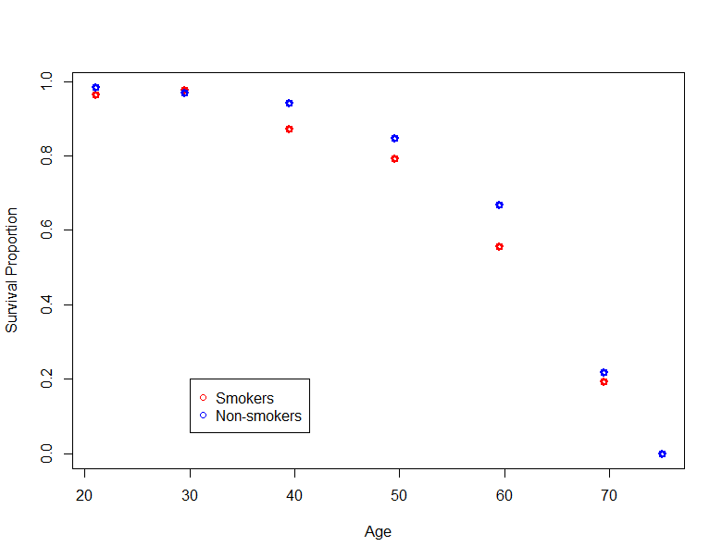
Data Example in R
## Read data in R
smoking <- read.table("CIGARETT.dat",sep="",row.names=NULL)
names(smoking) <- c("Age","Smoker","Survived","At.risk")
attach(smoking)
## Plot proportion of survival
plot(Age,Survived/At.risk, xlab="Age", ylab="Survival Proportion", col=c("red","blue"),lwd=3)
legend(30,0.2, legend=c("Smokers","Non-smokers"),pch=1, col=c("red","blue"))

Slide 6
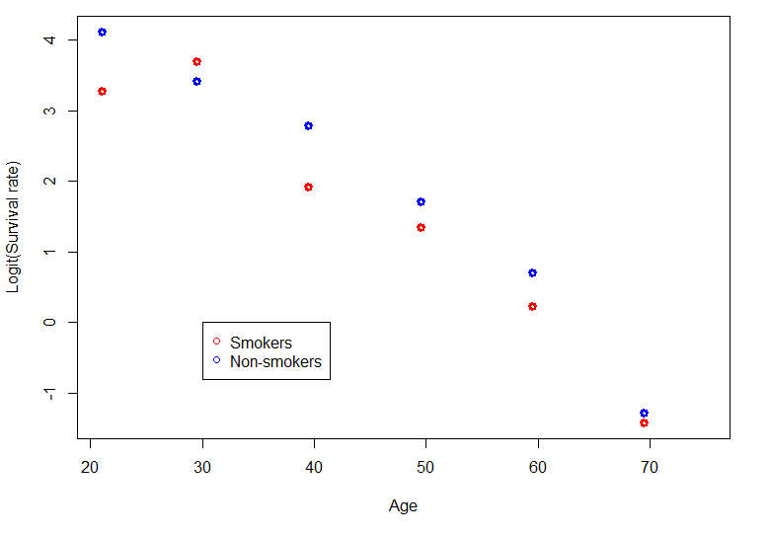
Data Example in R (cont’d)
## Plot of logit transformation of the proportion survival
prop.survival <-Survived/At.risk
plot(Age,log(prop.survival/(1-prop.survival)), col=c("red","blue"), xlab="Age", ylab="Logit(Survival Proportion)", lwd=3)
legend(30,0, legend=c("Smokers","Non-smokers"), pch=1, col=c("red","blue"))

Slide 7

Summary

